Slide 1
B-Trees - 2-3 Trees and AVL Trees
Balanced BSTs, Operations Insertions and Rotations
SoftUni Team
Technical Trainers
Software University
http://softuni.bg

Slide 2
Table of Contents
B-Trees
2-3 Trees
Ordered Operations
Insertion
AVL Trees
Properties of AVL
Rotations in AVL (Double Left, Double Right)
AVL Insertion Algorithm

Slide 3
17
9
15
6
5
8
16
Balanced BSTs
Balancing a BST

Slide 4
What is a Balanced Binary Search Tree?
Binary search trees can be balanced
Subtrees hold nearly equal number of nodes
Subtrees are with nearly the same height
17
10
25
5
15
19

Slide 5
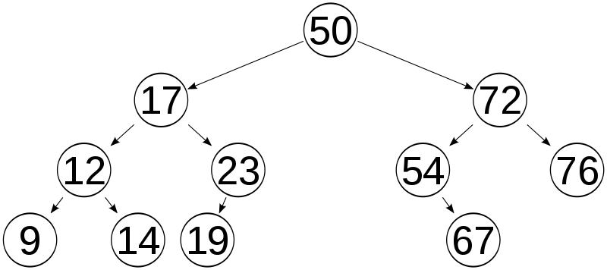
Balanced Binary Search Tree – Example
The left subtree holds 6 nodes
The right subtree holds 4 nodes
The left subtree has height of 3
The right subtree has height of 3

Slide 6
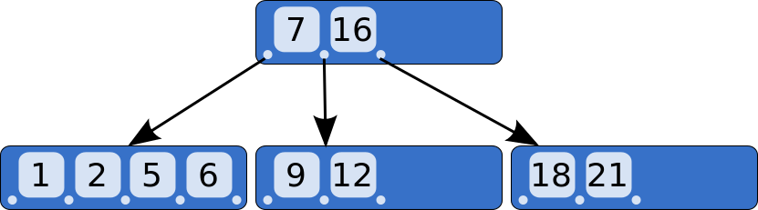
B-Trees
B-Trees Concept

Slide 7
What are B-Trees?
B-trees are generalization of the concept of ordered binary search trees – see the visualization
B-tree of order b has between b and 2*b keys in a node and between b+1 and 2*b+1 child nodes
The keys in each node are ordered increasingly
All keys in a child node have values between their left and right parent keys
B-trees can be efficiently stored on the hard disk

Slide 8
B-Tree – Example
B-Tree of order 3 (max count of child nodes), also known as 2-3 tree
13
7
11
41
3
5
9
12
32
50
73

Slide 9
B-Trees vs. Other Balanced Search Trees
B-Trees hold a range of child nodes, not single one
B-trees do not need re-balancing so frequently
B-Trees are good for database indexes
Because a single node is stored in a single cluster of the hard drive
Minimize the number of disk operations (which are very slow)
B-Trees are almost perfectly balanced
The count of nodes from the root to any null node is the same

Slide 10
2-3 Trees
2-3 Trees Operations

Slide 11
Definition
A 2-3 search tree can contain:
Empty node (null)
2-node with 1 key and 2 links (children)
3-node with 2 keys and 3 links (children)
As usual for BSTs, all items to the left are smaller, all items to the right are larger.

Slide 12
2-3 Tree Example
3-node with 2 keys and 3 links
13
2-node with 1 key and 2 links
7
11
41
Smaller than 7
Larger than 11
3
5
9
12
32
50
73
Larger than 7, smaller than 11

Slide 13
2-3 Tree Searching
Searching for 12
Identical to BST Search
13
7
11
41
3
5
9
12
32
50
73

Slide 14
2-3 Tree Insertion (at 2-node)
Becomes a 3-node
13
30

Slide 15
2-3 Tree Insertion (at 3-node)
Temporary
4-node
13
30
50

Slide 16
2-3 Tree Insertion
Into a 3-node whose parent is a 2-node
9
9
Insert 40
31
52
31
40
52
9
40
31
52

Slide 17
2-3 Tree Insertion (2)
Into a 3-node whose parent is a 3-node
30
50
30
50
Insert 25
10
20
10
20
25
30
20
30
50
20
50
10
25
10
25

Slide 18
2-3 Tree Construction
Insert 50
50

Slide 19
2-3 Tree Construction (2)
Insert 30
30
50

Slide 20
2-3 Tree Construction (3)
Insert 35
30
35
50
35
30
50

Slide 21
2-3 Tree Construction (4)
Insert 20
35
20
30
50

Slide 22
2-3 Tree Construction (5)
Insert 10
35
10
20
30
50
20
35
10
30
50

Slide 23
2-3 Tree Construction (6)
Insert 70
20
35
10
30
50
70

Slide 24
2-3 Tree Construction (7)
Insert 33
20
35
10
30
33
50
70

Slide 25
2-3 Tree Construction (8)
Insert 40
20
35
10
30
33
40
50
70
20
35
50
10
30
33
40
70

Slide 26
2-3 Tree Construction (9)
35
20
50
10
30
33
40
70

Slide 27
2-3 Tree Properties
Unlike standard BSTs, 2-3 trees grow from the bottom
The number of links from the root to any null node is the same
Transformations are local
Nearly perfectly balanced
Inserting 10 nodes will result with height of the tree 2
For normal BSTs the height can be 9 in the worst case

Slide 28
2-3 Tree - Quiz
TIME’S UP!
TIME:
Suppose that you are inserting a new node to a 2-3 tree. Under which of the following scenarios must the height of the 2-3 tree increase by one?
Number of nodes is equal to power of 2
Number of nodes is one less than a power of 2
When the final node on a search path from the root is a 3-node
When every node on the search path from the root is a 3-node

Slide 29
2-3 Tree - Answer
Suppose that you are inserting a new node to a 2-3 tree. Under which of the following scenarios must the height of the 2-3 tree increase by one?
Number of nodes is equal to power of 2
Number of nodes is one less than a power of 2
When the final node on a search path from the root is a 3-node
When every node on the search path from the root is a 3-node

Slide 30
2-3 Tree - Summary
Structure | Worst case |  |  | Average case
 | Search | Insert | Delete | Search Hit | Insert
BST | N | N | N | 1.39 lg N | 1.39 lg N
2-3 Tree | c lg N | c lg N | c lg N | c lg N | c lg N
Constants depend on implementation

Slide 31
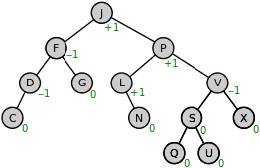
AVL Trees
Properties and Rotations

Slide 32
AVL Tree
AVL tree is a self-balancing binary-search tree (visualization)
Height of two subtrees can differ by at most 1
17
 | Average | Worst case
Space | O(n) | O(n)
Search | O(log n) | O(log n)
Insert | O(log n) | O(log n)
Delete | O(log n) | O(log n)
9
25
5
12

Slide 33
AVL Tree Rebalancing
Height difference is measured by a balance factor (BF)
BF(Tree) = Height(Left) – Height(Right)
BF of any node is in the range [-1, 1]
If BF becomes -2 or 2 → rebalance
0
17
0
1
9
25
0
0
5
12
20
0

Slide 34
AVL Tree Rebalancing
Rebalancing is done by retracing
Start from inserted node's parent and go up to root
Perform rotations to restore balance
0
-1
17
0
1
2
9
25
0
0
5
12
20
0
1
19
0

Slide 35
Right Rotation
x
y
Set to be child of
Set Right Child of to be Left Child of
y
x
In Order Preserved
x
y
Right rotation (x)
y
C
A
x
A
B
B
C

Slide 36
Left Rotation
Set to be child of
Set Left Child of to be Right Child of
y
x
In Order Preserved
x
y
y
x
Left rotation (y)
A
x
y
C
B
C
A
B

Slide 37
AVL Tree Insertion Algorithm
4
Insert like in ordinary BST
Retrace up to root
Modify balance / height
If balance factor ∉ [-1,1] → rebalance
20
3
2
12
25
2
2
1
8
17
26
1
1
1
1
4
10
15
19

Slide 38
Insertion - #1
4
Insert 11
20
3
2
12
25
2
2
1
8
17
26
1
1
1
1
4
10
15
19

Slide 39
Insertion - #2
20
4
11 < → go left
20
3
2
12
25
2
2
1
8
17
26
1
1
1
1
4
10
15
19

Slide 40
Insertion - #3
12
4
11 < → go left
20
3
2
12
25
2
2
1
8
17
26
1
1
1
1
4
10
15
19

Slide 41
Insertion - #4
8
4
11 > → go right
20
3
2
12
25
2
2
1
8
17
26
1
1
1
1
4
10
15
19

Slide 42
Insertion - #5
10
4
11 > → go right
20
3
2
12
25
2
2
1
8
17
26
1
1
1
1
4
10
15
19

Slide 43
Insertion - #5
4
Right node is null → insert
Update height
balance is -1
20
10
3
2
10
12
25
2
2
1
8
17
26
1
2
1
1
4
10
15
19
1
11

Slide 44
Insertion - #5
8
4
Update height
balance is -1
20
8
3
2
12
25
3
2
1
8
17
26
1
2
1
1
4
10
15
19
1
11

Slide 45
Insertion - #5
12
4
Update height
balance is 1
20
12
4
2
12
25
3
2
1
8
17
26
1
2
1
1
4
10
15
19
1
11

Slide 46
Insertion - #5
20
5
Update height
balance is 2
is left heavy
rotate right
20
20
4
2
20
12
25
20
3
2
1
8
17
26
1
2
1
1
4
10
15
19
1
11

Slide 47
Insertion - #5
17
Switch parent
4
12
5
3
20
8
2
2
1
2
17
25
4
10
1
1
1
1
11
15
19
26

Slide 48
Insertion - #5
20
Update height
4
12
3
3
20
8
2
2
1
2
17
25
4
10
1
1
1
1
11
15
19
26

Slide 49
Insertion - #5
12
Update height
Balance is 0
4
12
12
3
3
20
8
2
2
1
2
17
25
4
10
1
1
1
1
11
15
19
26

Slide 50
Insertion - #5
Over
More: https://en.wikipedia.org/wiki/AVL_tree
4
12
3
3
20
8
2
2
1
2
17
25
4
10
1
1
1
1
11
15
19
26

Slide 51
AVL Tree - Quiz
Delete 25. What will be the resulting tree?
TIME’S UP!
TIME:
17
9
25
5
12

Slide 52
AVL Tree - Quiz
Delete 25. What will be the resulting tree?
TIME’S UP!
17
17
9
→
→
9
25
9
5
17
5
12
5
12
12

Slide 53

Double Rotations
Double Left, Double Right Rotation

Slide 54
Single Rotation Problem
Insert 4
2
5
-1
3
D
0
A
4
B
C

Slide 55
Single Rotation Problem (2)
Rotate a node with opposite balanced child
2
-2
Rotate Right 5 doesn’t solve it
5
3
-1
A
1
3
D
5
0
0
A
4
4
D
B
C
B
C

Slide 56
Double Right Rotation
Right-Left

Slide 57
Double Right Rotation
Rotate Right (node) with negatively balanced Left Child
2
5
-1
3
D
0
A
4
B
C

Slide 58
Double Right Rotation
Left Rotate 3
2
5
-1
D
3
0
A
4
B
C

Slide 59
AVL Tree - Double Rotations
Update Balance 3
2
5
0
4
D
-1
3
C
A
B

Slide 60
AVL Tree - Double Rotations
Update Balance 3
2
5
0
4
D
0
3
C
A
B

Slide 61
AVL Tree - Double Rotations
Right Rotate (5)
2
Reduced to Single Right (5)
5
1
4
D
0
3
C
A
B

Slide 62
AVL Tree - Double Rotations
Update Balance 5
1
4
0
2
3
5
A
B
C
D

Slide 63
AVL Tree - Double Rotations
Update Balance 4
1
4
0
0
3
5
A
B
C
D

Slide 64
AVL Tree - Double Rotations
Balance Restored!
0
4
0
0
3
5
A
B
C
D

Slide 65
Double Left Rotation
Left-Right

Slide 66
AVL Tree - Double Rotations
Rotate Left (node) with positively balanced Right Child
-2
5
1
D
3
0
A
4
C
B

Slide 67
AVL Tree - Double Rotations
Rotate Right (3)
-2
5
D
1
3
0
A
4
C
B

Slide 68
AVL Tree - Double Rotations
Update Balance (3)
-2
5
0
D
4
1
C
3
B
A

Slide 69
AVL Tree - Double Rotations
Update Balance (3)
-2
5
0
D
4
0
C
3
B
A

Slide 70
AVL Tree - Double Rotations
Rotate Left (5)
-2
Reduced to Single Left (5)
5
1
D
4
0
C
3
B
A

Slide 71
AVL Tree - Double Rotations
Update Balance (5)
1
4
-2
0
5
3
D
B
C
A

Slide 72
AVL Tree - Double Rotations
Update Balance (5)
1
4
0
0
5
3
D
B
C
A

Slide 73
AVL Tree - Double Rotations
Update Balance (4)
0
4
0
0
5
3
D
B
C
A

Slide 74
AVL Tree - Quiz
Insert 22. What will be the resulting tree?
TIME’S UP!
TIME:
17
9
25
5
12
20

Slide 75
AVL Tree - Quiz
Insert 22. What will be the resulting tree?
TIME’S UP!
17
17
17
→
→
9
25
9
25
9
22
5
12
20
5
12
20
5
12
20
25
22

Slide 76
AVL Tree - Summary
Structure | Worst case |  |  | Average case
 | Search | Insert | Delete | Search Hit | Insert
BST | N | N | N | 1.39 lg N | 1.39 lg N
2-3 Tree | c lg N | c lg N | c lg N | c lg N | c lg N
Red-Black | 2 lg N | 2 lg N | 2 lg N | lg N | lg N
AVL Tree | 1.44 lg N | 1.44 lg N | 1.44 lg N | lg N | lg N
Insert/Delete perform O(lgN) rotations

Slide 77
17
9
25
5
12
20
22
AVL Tree
Balancing Implementation

Slide 78
Rotate Right
public Node<T> rotateRight(Node<T> node) {
Node<T> left = node.left;
node.left = node.left.right;
left.right = node;
updateHeight(node);
return left;
}

Slide 79
Balance Node
private Node<T> balance(Node<T> node) {
int balance = height(node.Left) - height(node.Right);
if (balance < -1) // Right child is heavy {
balance = height(node.right.left) - height(node.right.right);
if (balance <= 0) { return rotateLeft(node); }
else { node.right = rotateRight(node.right); return rotateLeft(node); }
}
else if (balance > 1) // Left child is heavy {
balance = height(node.Left.Left) - height(node.Left.Right);
if (balance >= 0) { return rotateRight(node); }
else { node.left = rotateLeft(node.left); return rotateRight(node); }
}
return node;
}

Slide 80

Summary
…
…
…
B-Trees can be efficiently sored on disks
2-3 tree is B-Tree of order 3
Not perfectly balanced
Performs local transformations
AVL Trees
Rotations right and left
Double rotations

Slide 81
https://softuni.bg/modules/59/java-advanced

Slide 82













SoftUni Diamond Partners

Slide 83

Educational Partners

Slide 84
Trainings @ Software University (SoftUni)
Software University – High-Quality Education, Profession and Job for Software Developers
softuni.bg, about.softuni.bg
Software University Foundation
softuni.foundation
Software University @ Facebook
facebook.com/SoftwareUniversity
Software University Forums
forum.softuni.bg
84
Notes:
84

Slide 85

License
This course (slides, examples, demos, exercises, homework, documents, videos and other assets) is copyrighted content
Unauthorized copy, reproduction or use is illegal
© SoftUni – https://about.softuni.bg/
© Software University – https://softuni.bg
Notes:
85

